Slide 1
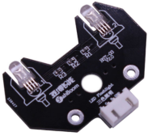
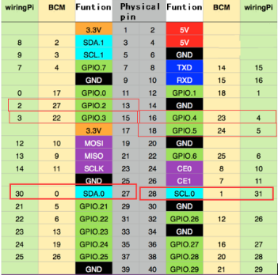
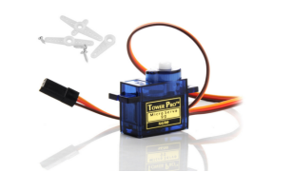
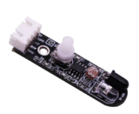
초음파 회피 로봇
RGB 모듈
SG90 servo
0.5ms-----------------0° 1.0ms-----------------45° 1.5ms-----------------90° 2.0ms-----------------135° 2.5ms-----------------180°
적외선 센서

Slide 2
EchoPin = 0
TrigPin = 1
#Definition of RGB module pins
LED_R = 22
LED_G = 27
LED_B = 24
#Definition of servo pin
ServoPin = 23
#Definition of infrared obstacle avoidance module pins
AvoidSensorLeft = 12
AvoidSensorRight = 17
#Set the GPIO port to BCM encoding mode
GPIO.setmode(GPIO.BCM)

Slide 3
def init():
global pwm_ENA
global pwm_ENB
global pwm_servo
#생략
GPIO.setup(key,GPIO.IN)
GPIO.setup(EchoPin,GPIO.IN)
GPIO.setup(TrigPin,GPIO.OUT)
GPIO.setup(LED_R, GPIO.OUT)
GPIO.setup(LED_G, GPIO.OUT)
GPIO.setup(LED_B, GPIO.OUT)
GPIO.setup(ServoPin, GPIO.OUT)
GPIO.setup(AvoidSensorLeft,GPIO.IN)
GPIO.setup(AvoidSensorRight,GPIO.IN)
#Set the PWM pin and frequency is 2000hz
pwm_ENA = GPIO.PWM(ENA, 2000)
pwm_ENB = GPIO.PWM(ENB, 2000)
pwm_ENA.start(0)
pwm_ENB.start(0)
pwm_servo = GPIO.PWM(ServoPin, 50)
pwm_servo.start(0)

Slide 4
#The servo rotates to the specified angle
def servo_appointed_detection(pos):
for i in range(18):
pwm_servo.ChangeDutyCycle(2.5 + 10 * pos/180)

Slide 5
def servo_color_carstate():
#red
GPIO.output(LED_R, GPIO.HIGH)
GPIO.output(LED_G, GPIO.LOW)
GPIO.output(LED_B, GPIO.LOW)
back(20, 20)
time.sleep(0.08)
brake()
servo_appointed_detection(0)
time.sleep(0.8)
rightdistance = Distance_test()
servo_appointed_detection(180)
time.sleep(0.8)
leftdistance = Distance_test()
servo_appointed_detection(90)
time.sleep(0.8)
frontdistance = Distance_test()
if leftdistance < 30 and rightdistance < 30 and frontdistance < 30:
#Magenta
GPIO.output(LED_R, GPIO.HIGH)
GPIO.output(LED_G, GPIO.LOW)
GPIO.output(LED_B, GPIO.HIGH)
spin_right(85, 85)
time.sleep(0.58)
elif leftdistance >= rightdistance:
#Blue
GPIO.output(LED_R, GPIO.LOW)
GPIO.output(LED_G, GPIO.LOW)
GPIO.output(LED_B, GPIO.HIGH)
spin_left(85, 85)
time.sleep(0.28)
elif leftdistance <= rightdistance:
#Magenta
GPIO.output(LED_R, GPIO.HIGH)
GPIO.output(LED_G, GPIO.LOW)
GPIO.output(LED_B, GPIO.HIGH)
spin_right(85, 85)
time.sleep(0.28)

Slide 6
while True:
distance = Distance_test()
if distance > 50:
LeftSensorValue = GPIO.input(AvoidSensorLeft)
RightSensorValue = GPIO.input(AvoidSensorRight)
if LeftSensorValue == True and RightSensorValue == True :
run(40, 40)
elif LeftSensorValue == True and RightSensorValue == False :
spin_left(30, 30)
time.sleep(0.002)
elif RightSensorValue == True and LeftSensorValue == False:
spin_right(30, 30)
time.sleep(0.002)
elif RightSensorValue == False and LeftSensorValue == False :
spin_right(30, 30)
time.sleep(0.002)
run(40, 40)
GPIO.output(LED_R, GPIO.LOW)
GPIO.output(LED_G, GPIO.HIGH)
GPIO.output(LED_B, GPIO.LOW)

Slide 7
elif 30 <= distance <= 50:
LeftSensorValue = GPIO.input(AvoidSensorLeft)
RightSensorValue = GPIO.input(AvoidSensorRight)
if LeftSensorValue == True and RightSensorValue == True :
run(40, 40)
elif LeftSensorValue == True and RightSensorValue == False :
spin_left(30, 30)
time.sleep(0.002)
elif RightSensorValue == True and LeftSensorValue == False:
spin_right(30, 30)
time.sleep(0.002)
elif RightSensorValue == False and LeftSensorValue == False :
spin_right(30, 30)
time.sleep(0.002)
run(40, 40)
elif distance < 30:
servo_color_carstate()

